Slide 1
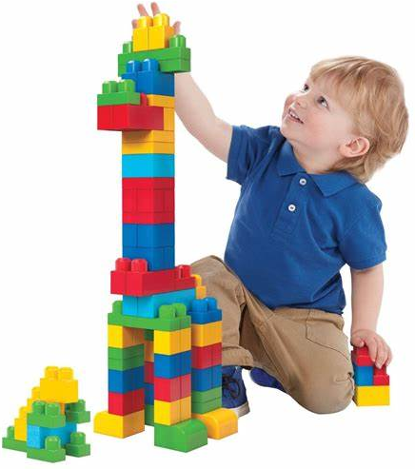


Learning Maths in the Early Years
A guide for parents and carers
Notes:
Explain we have an accompanying booklet. No need to write everything down!
I have included some activity suggestions in the slides to make a workshop more interactive

Slide 2
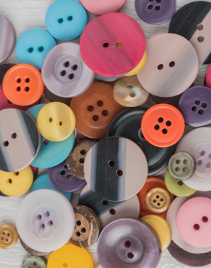
Aims of the guide
To understand the importance of maths in the early years and how it lays the foundations for future learning
To explore the ‘big ideas’ in early years maths
To begin to understand the progression in mathematical concepts
To understand ways in which you can further support your child with maths at home

Slide 3
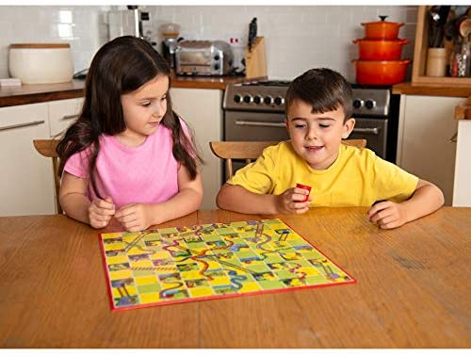
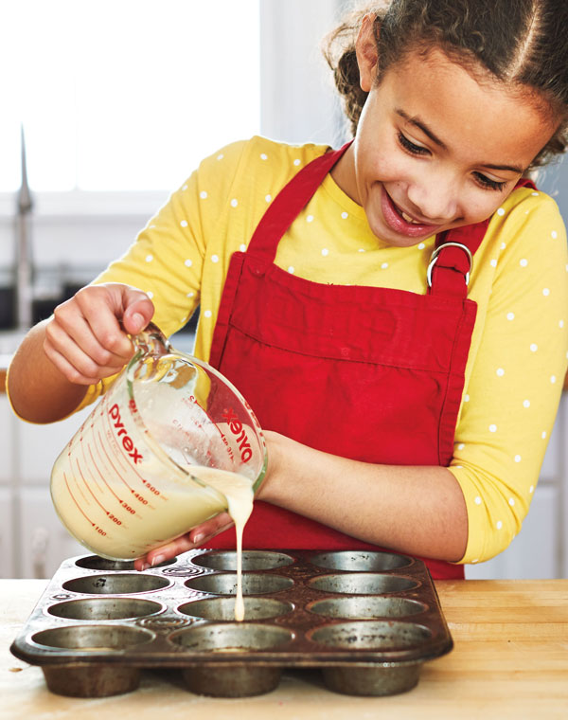

Time to reflect
Take a minute to think about your earliest memory of maths. What do you remember?
Notes:
Some people will have positive memories of maths. Others may have had negative experiences. Discuss activities that may have been maths based without necessarily realising it. Most people who have shared positive shared experiences, focused on shared experiences and recalled games such as snap, snakes and ladders and hopscotch

Slide 4

Our attitudes towards maths
Some key points to consider…
Maths can be fun and enjoyable for you and your child
We all learn best when we enjoy an activity so making it fun is essential for children in the early years. Not every child will enjoy every activity though and that is OK. You know your child best!
There is no such things as a ‘maths person’ or a ‘maths brain’
We all know how easily children pick up on the things we say and we want them to hear positive messages around maths. Every child has the potential to succeed in maths and make progress at their own rate.
Maths does not need to be written down to be ‘real maths’
Children learn best by ‘doing’ and learning through play is central to the early years curriculum. Maths does not have to always be recorded. You will be doing maths everyday with your child without even realising it!
Making mistakes and talking about them is an important part of learning maths
Children will make mistakes and this is OK. In making mistakes, children learn to problem solve and explain their thinking. These are key skills needed to be successful in maths.
It’s all about confidence
For children to be good at maths, they need to feel confident about giving it a go. Praising your child for their effort, not their ability, will increase their confidence and make them hungry to learn more.
Notes:
Evaluating our own attitudes to maths will help us to support our children

Slide 5

Maths for babies
From the moment they are born, babies begin to form ideas about maths through everyday experiences and, most important, through interactions with adults. You might have noticed that babies:
Notice when a basket or container has ‘lots’ of things in compared to just ‘one thing’
Explore what they can do with objects as well as their hands, feet and bodies
Clap with you when you sing to them
Search for hidden objects
Begin to join in with number songs and rhymes
Recognise objects that are used for specific times of the day such as mealtimes and nappy time
Stack blocks and make lines with bricks
Begin to sort objects and toys
Notes:
Children are born with an innate mathematical ability. See ‘What to expect, when?’ for more information. This is referenced at the end of the presentation

Slide 6
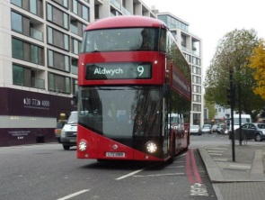
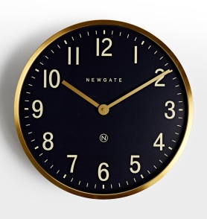
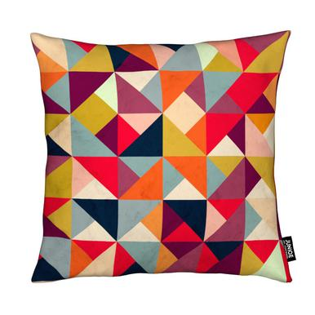
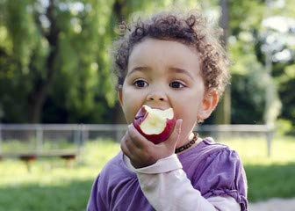
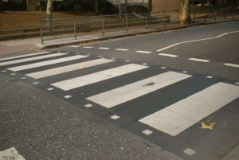
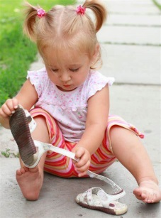
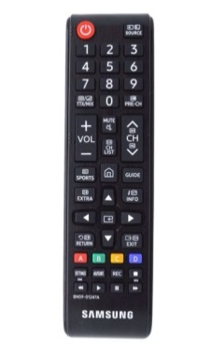
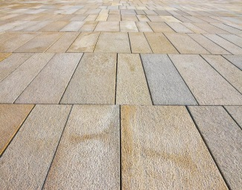


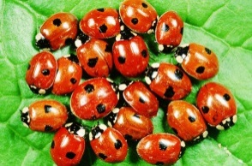

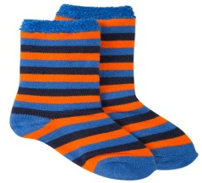
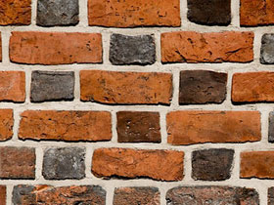
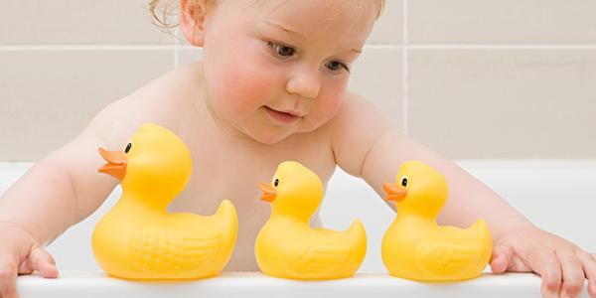
Maths is all around us
Maths is everywhere and it doesn’t just happen in Nursery or school. Young children need help to understand what maths is used for and you can do this by talking about the maths you use in your day-to-day routine. You can show them how numbers, size, shape and pattern are important in life by:
Talking about the numerals they see in their environment
Discussing patterns and shapes in their environment
Counting and making reference to quantity as part of your daily routine
Notes:
Emphasise the importance of using the daily routine, every day objects and the environment to talk about maths. Children need to understand that maths has a purpose

Slide 7
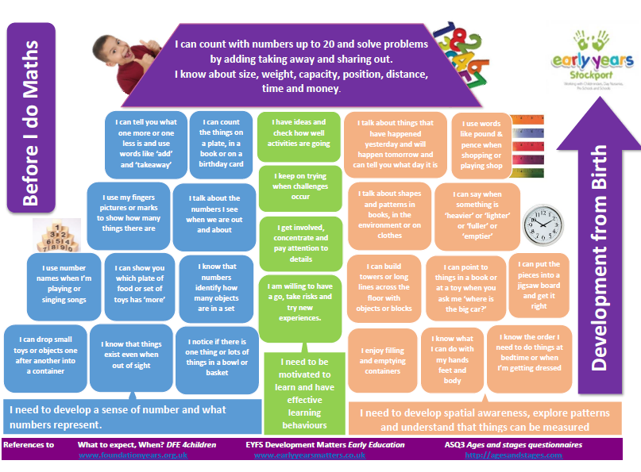
These are the expectations for the end of children’s Reception year
The blue and orange blocks refer to what children need to know in order to meet the expectations at the end of Reception
The green blocks refer to how children learn
Notes:
Building Blocks to Early Years Maths. This is available on Learning Leads.
Although, children are expected to count to 20, there is much research to suggest that children need develop a deep conceptual understanding of numbers to 10, the relationships between them and the patterns therein.

Slide 8


The big ideas of early years maths
The National Centre for Excellence in the Teaching of Mathematics (NCETM) refer to six big ideas which ‘collectively provide a platform for everything children will encounter as they progress through their maths learning at primary school, and beyond.’ They are:
Counting and cardinality
Comparison
Composition
Pattern
Shape and Space
Measures
Notes:
Discuss each big idea one at a time and explore how parents can help at home

Slide 9
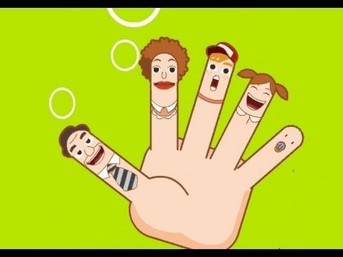
Counting and cardinality
The stages of counting
Stable order principle:
This is where children consistently use the number words in the same order. Before children can count five objects they need to be able to say the numbers 1,2,3,4,5 in order
One to one principle:
This is where children count every item in a set only once, using only one number word for each item
Cardinal Principle:
This is where a child understands that the last number word used represents the cardinality (total amount) of the set. A child is still developing this skill if they count 5 objects and have to recount when asked how many there are in total
Notes:
You will find a video of a child developing cardinality at: http://prek-math-te.stanford.edu/counting/additional-counting-videos

Slide 10

So how can you help?

Slide 11
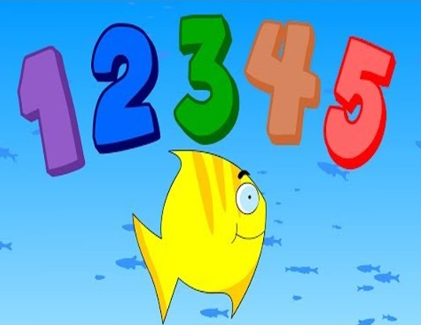
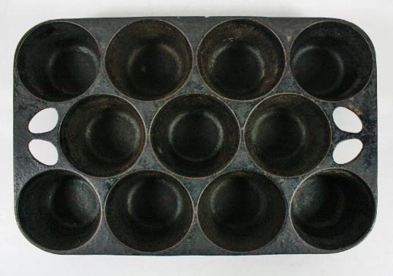
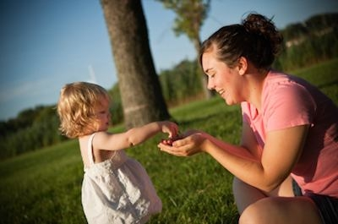
Counting and cardinality
Stable Order Principle (saying number names in order). You can help by:
Singing and playing number songs and rhymes and encouraging children to count using their fingers
Playing counting games such as ‘hide and seek’
Counting steps, jumps and actions with you child
One to one principle (using one number name for each item counted). You can help by:
Encouraging children to touch and count objects they can see. For example, can they count each brick when building a tower? Can they count the number of rubber ducks in the bath?
Counting a set of objects into trays and containers, one at a time. For example, when baking
Modelling counting objects in your own daily routine
Cardinal principle (the last number counted represents the total amount). You can help by:
Encouraging your child to count out from a bigger group. For example, can you ask them to get you two biscuits from a group of five biscuits?
Dice games where children count out the number they see on a dice
Number hunts. For example, can your child find two leaves and two sticks in the park?
Notes:
Link to a collection of nursery rhymes on cbeebies at the end of the slides

Slide 12



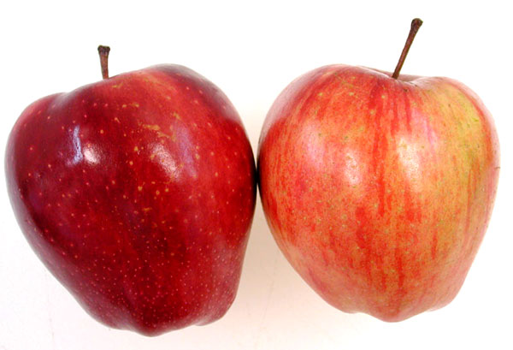
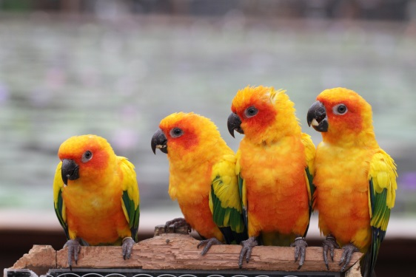
From a young age children develop the ability to perceive the number of a group of items) at a glance and without counting. This is known as subitising.
You can help your child by simply verbalising the number of up to five objects in your every day interactions:
“Can you pass me the two apples?”
“Can see four birds?”

Slide 13
Comparison
Comparing numbers involves knowing which numbers are worth more or less than each other. This depends both on understanding cardinal values of numbers and also knowing that the later counting numbers are worth more (because the next number is always one more). This understanding underpins the mental number line which children will develop later. When comparing children in the early years need to:
Compare groups of objects to say which group has ‘more’
Explore when groups of objects contain an equal amount
Compare numbers and reason. For example, by explaining they would like 5 sweets instead of 3 because 5 is more than 3.
Explore when sharing objects might be unfair and discuss why
Know the one more and one less relationship between numbers. For example, if there are 4 pencils in pot that is labelled 5, do they know to add one more?

Slide 14
So how can you help?

Slide 15
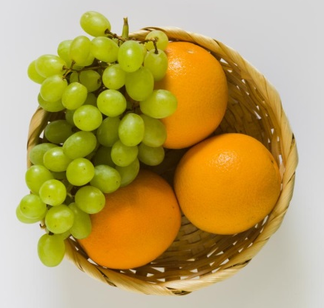
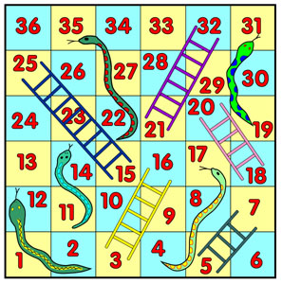
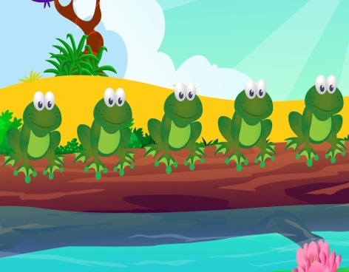
Comparison
Allow children to sort and compare collections of objects in the house. For example, when tidying up, can they identify which box has ‘more’ toys? Can they see when the amount of toys is equal?
Provide opportunities to compare objects of different sizes? For example, can they see that 5 small grapes is more than 3 large oranges?
Ask children to make two unequal groups equal and bring this into their play. For example, by saying ‘this doll has 4 biscuits and this doll has 1 biscuit. How can we make it fair?
Play ‘track games’ where children have to move counters onto bigger numbers
Use the language of ‘one more’. For example, by asking them to ‘eat one more spoonful’ at dinner time or put ‘one more penny in the jar’
Ask children to make predictions in number songs when an object is added or taken away. For example, by saying ‘there are 5 frogs on the log. If 1 jumps off how many will there be? How do you know?

Slide 16
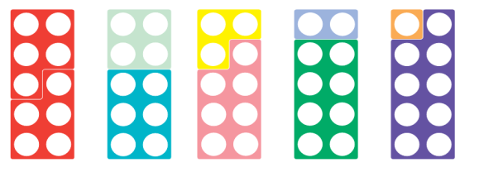
Composition
This refers to the knowledge that numbers are made up of two or more other smaller numbers and it involves ‘part–whole’ understanding. Learning to ‘see’ a whole number and its parts at the same time is a key development in children’s number understanding.
Partitioning (separating) numbers into other numbers and putting them back together again underpins understanding of addition and subtraction. Children in the early years will need:
Opportunities to see small numbers within a larger collection. For example, to see 5 and notice 4 and 1 and 3 and 2
Opportunities to partition a number of things into two groups, and to recognise that those groups can be recombined to make the same total
Opportunities to partition a whole number to see pairs of numbers that make the same total. For example. 10 is 5 and 5. 10 is 9 and 1. These can be referred to as number bonds to 10
To discover that numbers can be partitioned into more than two groups
Opportunities to say how many are hidden in a known number of things. For example: ‘Five children go into a tent, then two come out. How many are left in the tent?’
To begin to explore the value of teen numbers, for example, that 18 is 10 and 8
Notes:
Composition supports children’s fluency when calculating

Slide 17
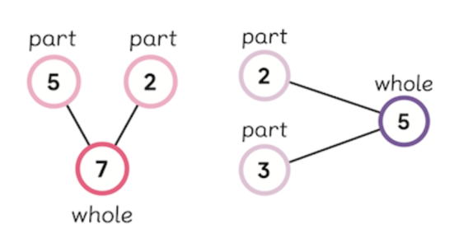

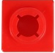
Number bonds can be represented by circles connected by lines. The ‘whole’ is written in the first circle, while the ‘parts’ are in the adjoining circles. Your child may be familiar with seeing them or using them to help them solve problems in their play.
PROBLEM: Can you put 4 cupcakes on 2 plates?
The child should experience using real objects as much as possible. They can then move onto representing their problem using counters. For example, in this case by pretending that 1 counter represents 1 cake. Finally, they can record using the numerals
4
4
3
1
3
1
Only once they are comfortable with this process, children may then progress to representing their problems in a more abstract way, for example, using the equation 3+1=4.
Notes:
This can be shared to explain the number bond diagram if appropriate. Also, demonstrates the Concrete, Pictorial, Abstract (CPA) approach

Slide 18
So how can you help?

Slide 19
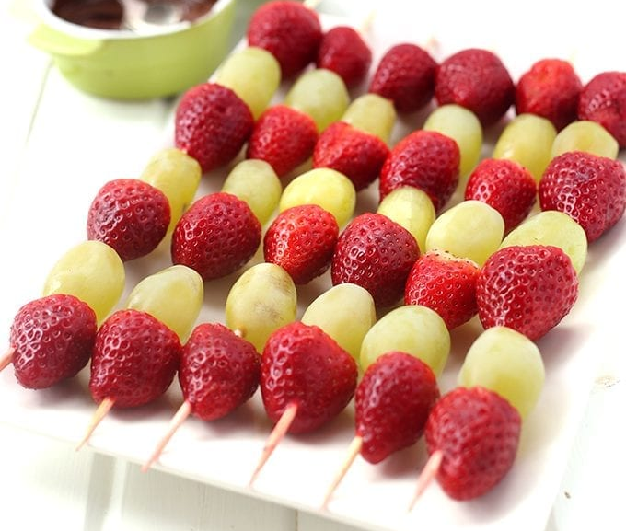
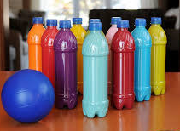
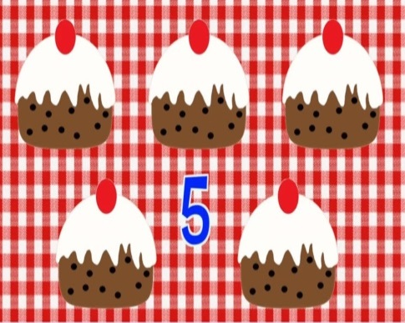
Composition
Encourage children to make different arrangements and patterns with five objects. For example, five sweets, five stones etc
Make a number with two different kinds of objects. For example, make a fruit skewer with five pieces of fruit, using bowls of grapes and strawberries to choose from
Play skittles outdoors. How many bottles are still standing? How many have fallen down? How many are there altogether?
Explore songs such as ‘Five Currant Buns’ – show that the whole is still five, but some are in the shop and some have been taken away. Check throughout that there are still five currant buns
Plant seeds outdoors and discuss how many seeds can go in each pot. How many are there altogether?
Notes:
Activity suggestion: Play bunny ears!
https://nrich.maths.org/content/id/14005/Number%20Talks%203.pdf

Slide 20
Pattern
Seeking and exploring patterns is at the heart of mathematics. Developing an awareness of pattern helps young children to notice and understand mathematical relationships. Patterns may provide the foundations of algebraic thinking, since they provide the opportunity for young children to observe and verbalise generalisations. Children in the early years will begin to:
Continue, copy and make their own patterns. Starting with what we call AB patterns such as a ‘red-blue’ pattern
Identify errors within patterns
Identify the unit that repeats. For example, in the AB pattern, the ‘red-blue’ would be the unit that is repeated. In an ABC pattern it would be the ‘red-blue-green’
Explore more complex pattern structures such as ABB patterns which have two items in the same unit of repeat such as ‘red, blue, blue’
Make patterns with a range of different objects and natural materials
Explore recording their patterns
Experiment with sound and action patterns
Make patterns which repeat round in a circle not just in a line
Notice and talk about patterns they see in their environment

Slide 21
So how can you help?

Slide 22
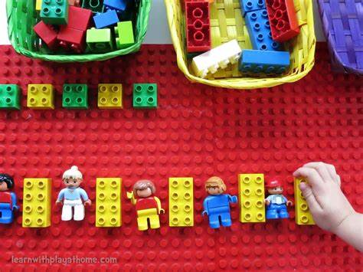

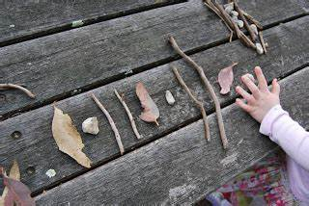
Pattern
Continue, copy and make patterns, firstly using identical objects of different colours, such as, blocks, Lego, beads and vehicles
Use range of objects and natural materials to make patterns. For example, using sticks, leaves stones and pine cones
Make action patterns together. For example, by clapping and jumping
Draw patterns outdoors using chalk
Talk about patterns you see in your house, on fabric, in the garden and/or local environment
Make fruit skewers or fruit faces and use the fruit to make a repeating pattern
Create sound patterns by making shakers or using pots and pans
Explore patterns in stories, songs and rhymes
Notes:
Activity suggestion: make action patterns with a partner

Slide 23
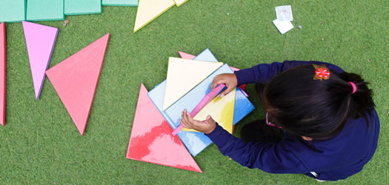
Shape and Space
The areas of shape and space are about developing visualising skills and understanding relationships, such as the effects of combining shapes together, rather than just knowing vocabulary. Spatial skills are important for understanding other areas of maths and children need some structured experiences to ensure they develop these. In the early years children need:
Opportunities to move both themselves and objects around, so they see things from different perspectives
To represent spacial relationships using construction or through their drawings. For example, by drawing a design of a model they want to make or drawing a simple map of outdoors
To be exposed to and use the language of position such as ‘in, on, under’ and direction such as ‘up, down, across’
To begin to identify and describe the properties of 2D and 3D shapes
Talk about the similarities and differences between shapes
To be exposed to shapes of different colours and sizes to reinforce the concept that shapes are defined by their properties not their size etc

Slide 24
So how can you help?

Slide 25
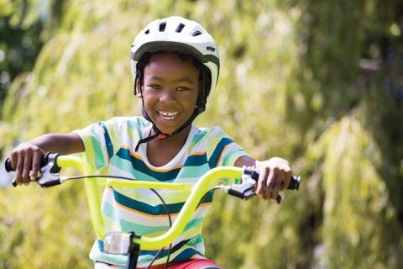
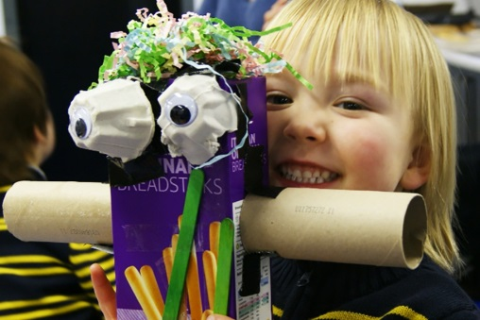
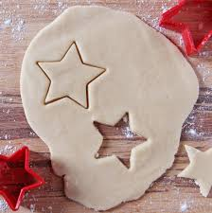
Shape and Space
Ride trikes and bikes through interesting routes and around obstacles
Explore jigsaws, shape sorters and posting activities
Engage in construction activities, for example, can they design and make a Lego model?
Make a complete circuit with a train track and direct the train which way to go
Treasure hunts. Hunt for hidden objects with directions
Make dens outside with a range of materials
Make a bug hotel and select materials fit for purpose
Use recycled materials such as cereal boxes to make and describe models
Make decorations by folding and cutting paper and card
Bake biscuits using a variety of shape cutters
Print and make pictures with patterns and shapes

Slide 26
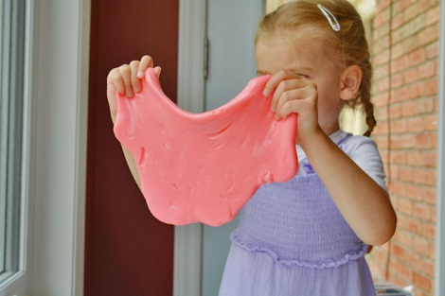
Measures
Learning how to measure and compare different sizes and different objects is an important life skill that contributes to our understanding of the concept of length, height, weight, capacity and time. Children learn most about measurement when they are engaged in practical activities. Children in the early years need to:
Recognise attributes of objects, for example, whether they are long, short, big, tall etc. They may point to objects until they become more familiar with the vocabulary
Begin to compare objects based on their length, height, weight and capacity. They may start to use language such as ‘longer than’ or ‘heavier than’
Begin to estimate and make predictions
Order objects in terms of their length, height, weight or capacity
Begin to explore using units to measure such as timers, identical sized bricks and height charts
Explore time by sequencing activities and events
Experience specific time durations, for example, by seeing how many jumps they can do in one minute

Slide 27
So how can you help?

Slide 28
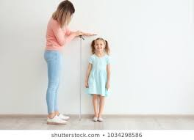
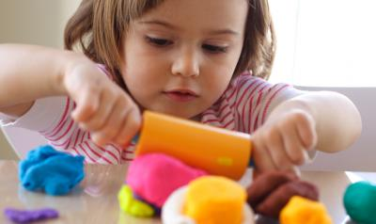
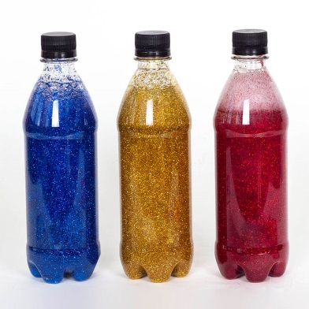
Measures
Use the language of size to describe everyday items
Roll and cut playdough worms and encourage your child to say which worm is the longest and which worm is the shortest
Grow and measure plants outdoors
Measure and compare the height of family members
Using balancing scales when baking to weigh ingredients
Make ‘glitter bottles’ using different sized bottles, water and glitter. Discuss which bottles holds the ‘most’ and which bottle holds the ‘least’
Use a calendar to count down to exciting events such as birthdays
Use timers to time races outdoors
Play ‘beat the timer’. Can they do 20 jumps before the timer runs out? How many hops can they do in 1 minute?

Slide 29
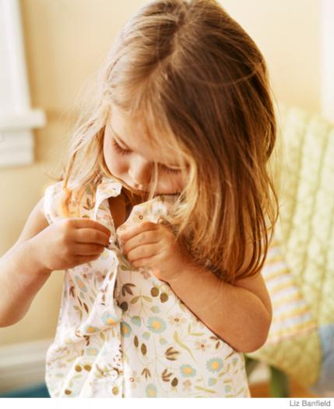
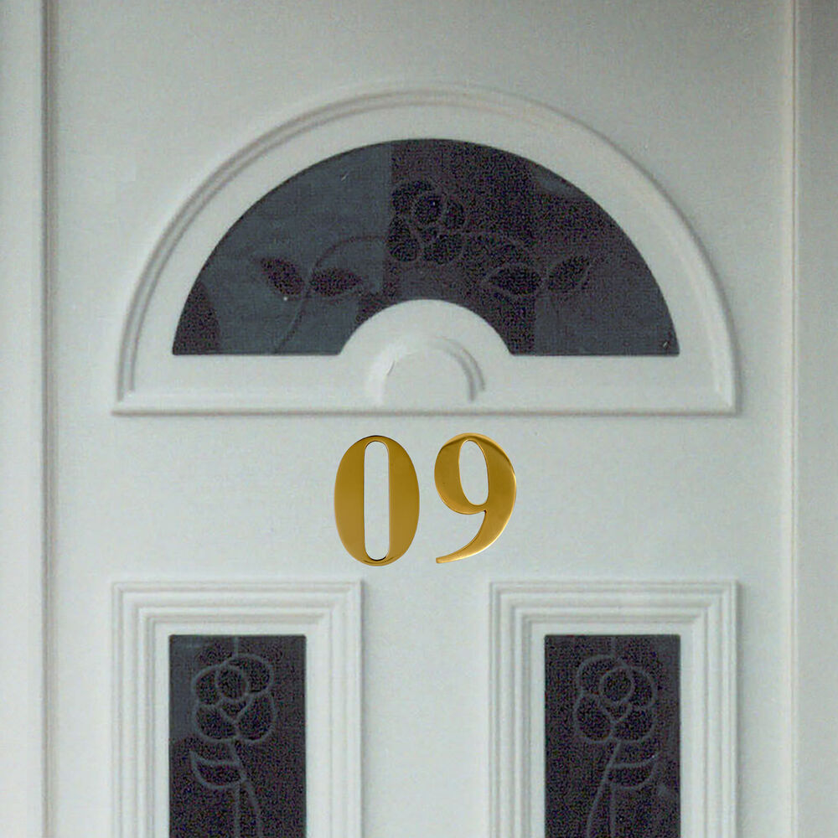
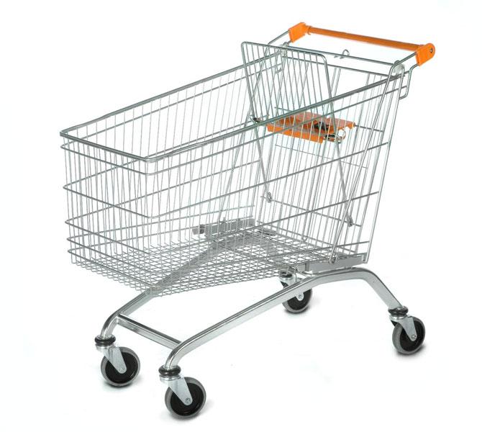

Maths is all around us
Remember, that maths is everywhere! You will be doing maths with your child as part of your daily activities. You can help your child by simply tuning in to and talking about the maths around you! Consider the following daily activities as maths opportunities:
Getting dressed…
The journey to school…
Going to the shop…
Bath time…
Talk about the order in which to get dressed in, and which items to put on first and last
Match pairs of things such as socks, shoes and gloves
Count the buttons on their top, dress or coat
Discuss colours, patterns, shapes and pictures on their clothes
Time how long it takes to get dressed. Can they beat the timer?
Count the things they see such as cars, people and animals
Look out for numerals on doors, buses and signs
Look at shapes on road signs
Discuss any patterns they see along the way, such as nature patterns
Time how long it takes them to walk or ride to school
Collect and count any special items such as conkers, feather and leaves
Count the number of food items needed or number of items on the shopping list
Count out items from the shelves
Count coins to give to the shopkeeper
Look for numerals on price labels
Compare which shopping bag is the heaviest and which is the lightest
Count the rubber ducks
Sing ‘5 little ducks went swimming one day…’
Fill different sized containers with water and explore which holds the most water. Use the language of ‘full’ and ‘empty’
Explore objects that float and sink
Explore how many objects they can count into a boat to make it sink
Notes:
Links back to slide 6

Slide 30

Mastery in Maths
‘Mastery’ refers to children gaining a deep understanding of maths and being able to understand, explain and apply their own learning. Children are given time to think about the maths in order to understand concepts rather than a set of rules or procedures.
In the early years, exploring bigger numbers does not necessarily mean a bigger challenge. When playing with your child or exploring maths activities consider these questions to develop a deeper understanding of maths:
How do you know? How can we prove it?
Can you show me?
I wonder if you can find another way?
I wonder if it is possible to…?
I wonder what would happen if…?
I wonder if you can explain it to your friend?
Can we draw it?
Notes:
Again, you may want to refer to the importance of developing a deep understanding of numbers to 10. These questions can help to challenge children working with numbers to 10

Slide 31
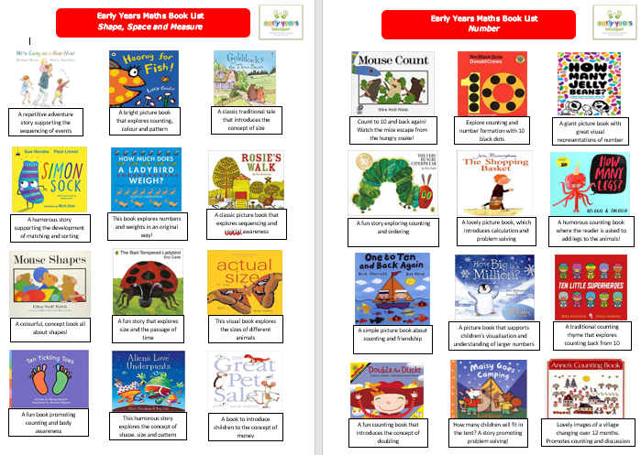

Stories to promote Maths
Please click on the link below to see a brief description of stories to promote Maths

Slide 32
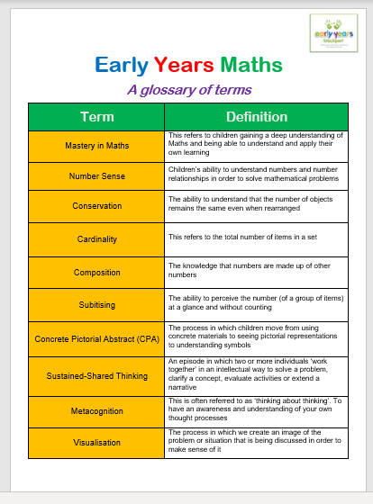
Understanding the lingo
Please click on the link below to see a glossary of Maths terms you may come across

Slide 33
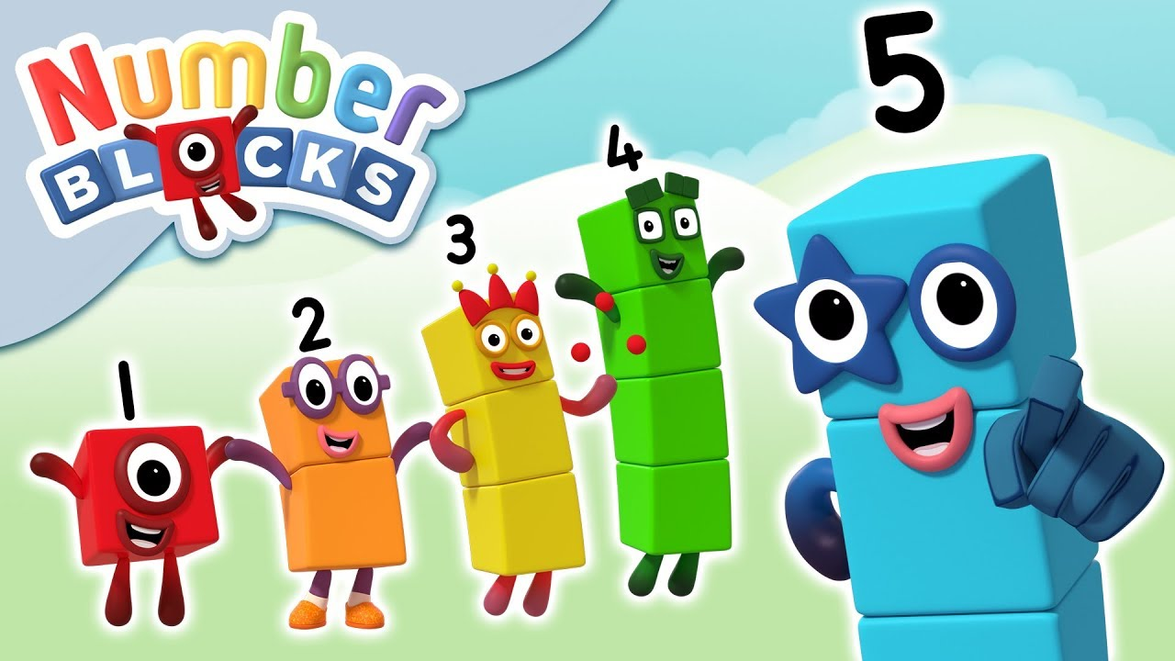
Useful links and resources
Number Blocks https://www.bbc.co.uk/cbeebies/shows/numberblocks?page=2
Nursery rhymes and counting songs
https://www.bbc.co.uk/teach/school-radio/nursery-rhymes-counting-medley/zj94y9q
Cbeebies Helping your child to be epic at maths
https://www.bbc.co.uk/cbeebies/grownups/help-your-child-with-maths
NRICH Activities for parents and children
https://nrich.maths.org/14588
What to expect, when?
https://www.foundationyears.org.uk/files/2015/03/4Children_ParentsGuide_2015_WEB.pdf

